Slide 1
Sentiment Analysis as an Indicator of Mental Health Issues
DSB 602 – Project 4 Group TBD

Slide 2
Mental Health By the Numbers
1 in 5 U.S. adults experience mental illness each year
1 in 20 U.S. adults experience serious mental illness each year
1 in 6 U.S. youth aged 6 – 17 experience a mental health disorder each year
Mental health issues include:
Anxiety disorders
Depression
Posttraumatic stress
Bipolar Disorder
Borderline Personality Disorder
Obsessive Compulsive Disorder
Schizophrenia

Slide 3
The Ripple Effect of Mental Illness
The Person has increased risk:
Cardiovascular and metabolic diseases
Substance abuse disorder
Unemployment
Suicide
Families Affected:
Caregiver to adults with mental health issues (avg of 32hr/ wk)
Communities Impacted:
Increased homelessness
Increased hospitalization → depression, psychosis, and mood disorders
U.S. Veterans and active service members suffer disproportionately
In the U.S. economy, serious mental illness causes $193.2 billion in lost earnings each year

Slide 4
Mental Health Resource Shortage
Current state of mental health care in U.S.:
Mental health organizations are understaffed
People are unable to access or afford mental health services
Counselors are overwhelmed with high caseloads
Reasons for mental health provider shortage:
Lack of funding → government provides a limited amount of funding
Poor reimbursement rates → providers are not adequately recompensed
Low Retention → negative stigma associated with mental health care profession
Increased need, limited access → demand is outpacing the supply of providers
Aging workforce → retiring health care professions and low retention rate are outpacing younger professionals entering the field

Slide 5
Problem Statement
Millions of people in the U.S. are affected by mental illness each year
However, resources for mental health limited in the U.S.
Also, culture tends to suppress those who need help from seeking it
It would be immensely valuable to provide a model which could predict whether an individual was suffering from various mental health issues
Using sentiment analysis as a backbone for classification could be an effective indication of possible mental health concerns
We'll use Recall/Sensitivity as our main metric since
False Positives would suggest people get help when they may not necessarily need (but everyone needs it) vs a false negative that could minimize serious health issues
We'll set our target at least 95% recall before production-ready

Slide 6
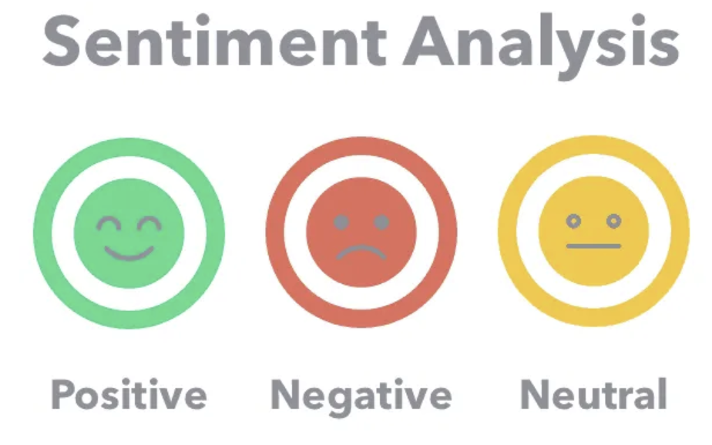
What is Sentiment Analysis?
The process of analyzing digital text to determine if the emotional tone of the message is positive, negative, or neutral
In today’s world, there are enormous volumes of text data
Emails
Chat transcripts
Social media comments
Sentiment analysis tools can scan this text to infer emotion
Sentiment analysis cam mine data information at great scale with reduced resources
The limited resources can then be focused on the potential problem issues (negative cases)

Slide 7
Sentiment Analysis for Mental Health – The Data
The dataset integrates information from the following Kaggle datasets:
Depression Reddit Cleaned
Human Stress Prediction
Predicting Anxiety in Mental Health Data
Mental Health Dataset Bipolar
Reddit Mental Health Data
Students Anxiety and Depression Dataset
Suicidal Mental Health Dataset
Suicidal Tweet Detection Dataset
Data Collection:
The data is sourced from diverse platforms including social media posts, Reddit posts, Twitter posts, and more
Each entry is tagged with a specific mental health status
Features:
unique_id: A unique identifier for each entry.
Statement: The textual data or post.
Mental Health Status: The tagged mental health status of the statement.

Slide 8
Model Methodology
Ames Dataset Imported
Selected Features from Dataset that best captured Critical Factors
Explored Data & Identified possible issues to fix and handle
Engineered & Transformed Data to match better w/ Critical Factors and min data issues
Modeled w/ 3 different Regression techniques
Evaluation of Performance

Slide 9
Metrics:

Slide 10
Model Fit Evaluation:

Slide 11
Evaluation:

Slide 12
Visual?

Slide 13
Conclusions and Recommendations

